Slide 1
Multi-way ANOVA
Power analysis
Crossed/factorial model
Two-way ANova

Slide 2
Example: Crop Yields

Slide 3
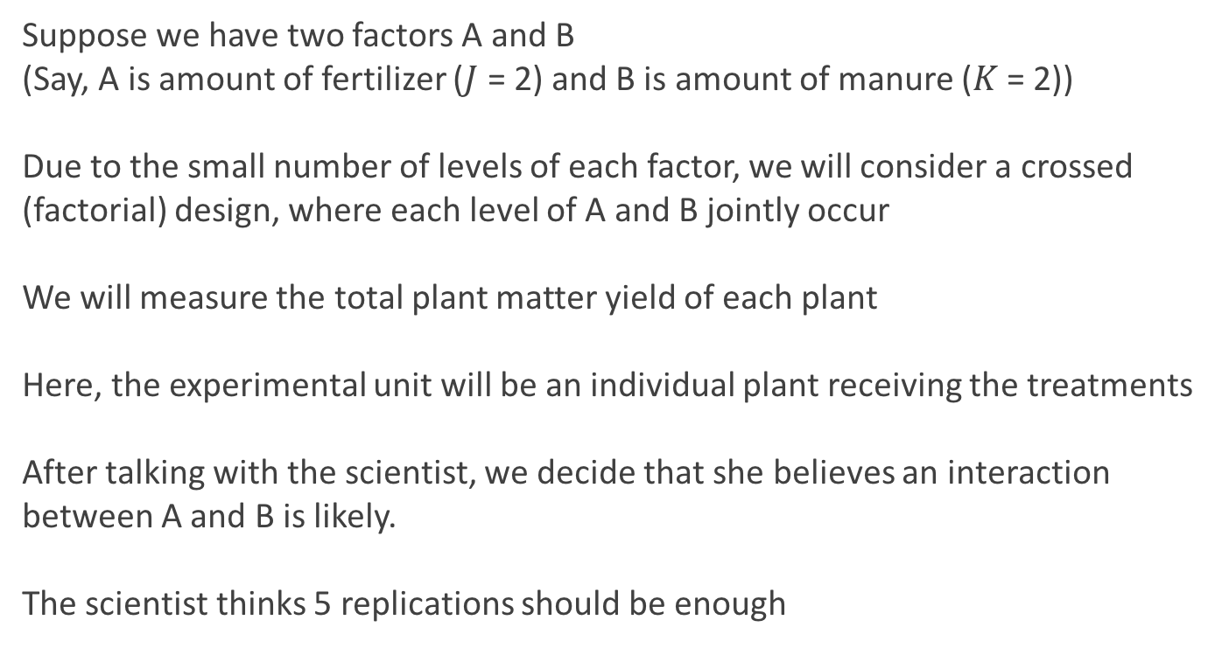
The Experimental Design
Suppose we have two factors A and B
(Say, A is amount of fertilizer ($J$ = 2) and B is amount of manure ($K$ = 2))
Due to the small number of levels of each factor, we will consider a crossed (factorial) design, where each level of A and B jointly occur
We will measure the total plant matter yield of each plant
Here, the experimental unit will be an individual plant receiving the treatments
After talking with the scientist, we decide that she believes an interaction between A and B is likely.
The scientist thinks 5 replications should be enough

Slide 4
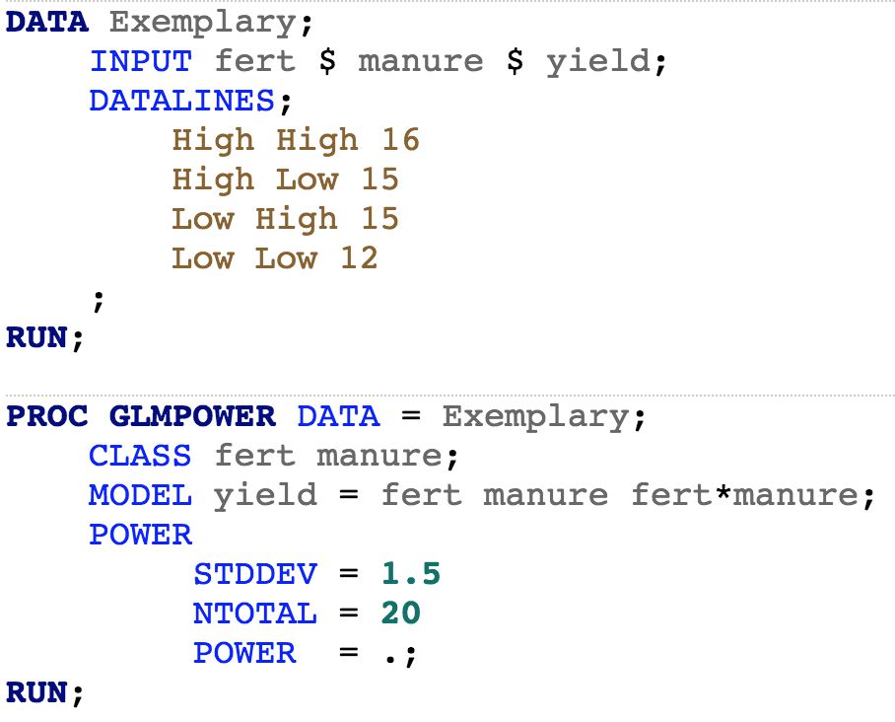
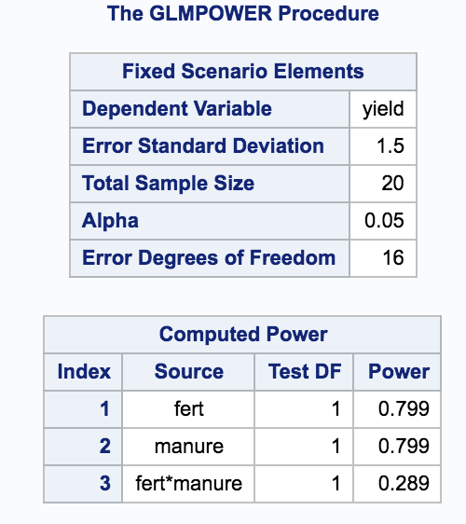
Power Analysis
The next step should always be a power analysis
Hopefully it will determine the set-up of the experiment
But at least it will provide added information if there is no estimated effect
We need to elicit:
Effect sizes we wish to detect
The considered model
The expected variability of the experiment

Slide 5
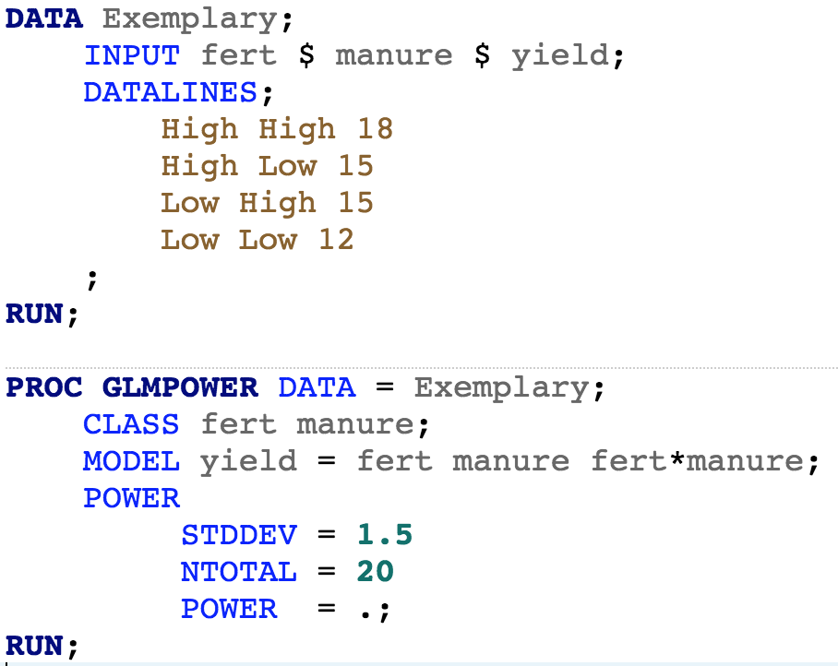

Power Analysis
What about this scenario (hint: sketch the profile plot):

Slide 6

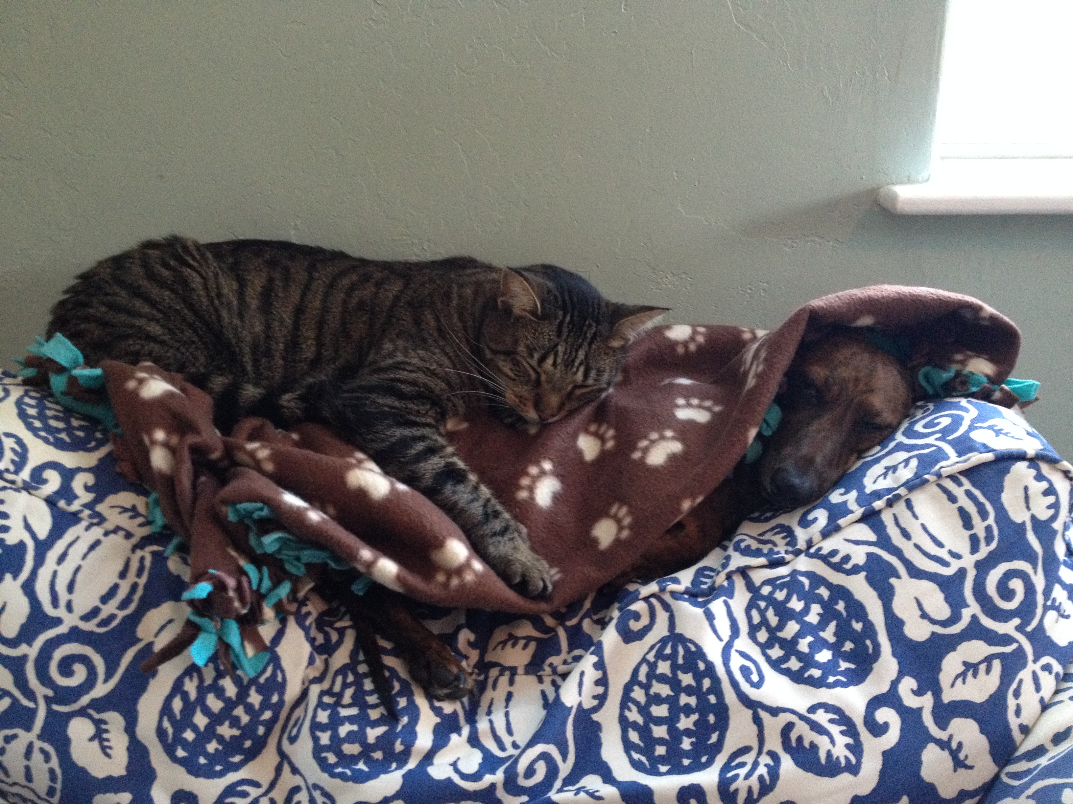
The Experiment
After discussing the results of the power analysis, we agree that 5 replications and a crossed design is appropriate….
For the next few weeks, the experiment is conducted..
Scientists
Statisticians

Slide 7
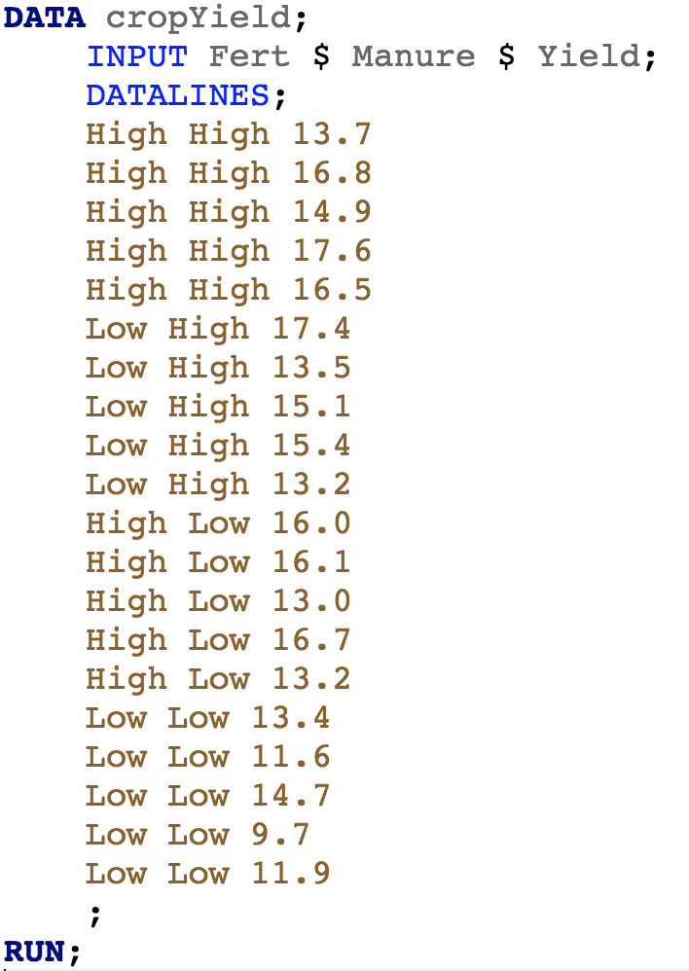
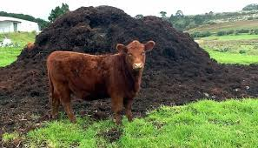
The Data
After discussing the results of the power analysis, we agree that 5 replications and a crossed design is appropriate….
For the next few weeks, the experiment is conducted..

Slide 8
Detour: Notation

Slide 9
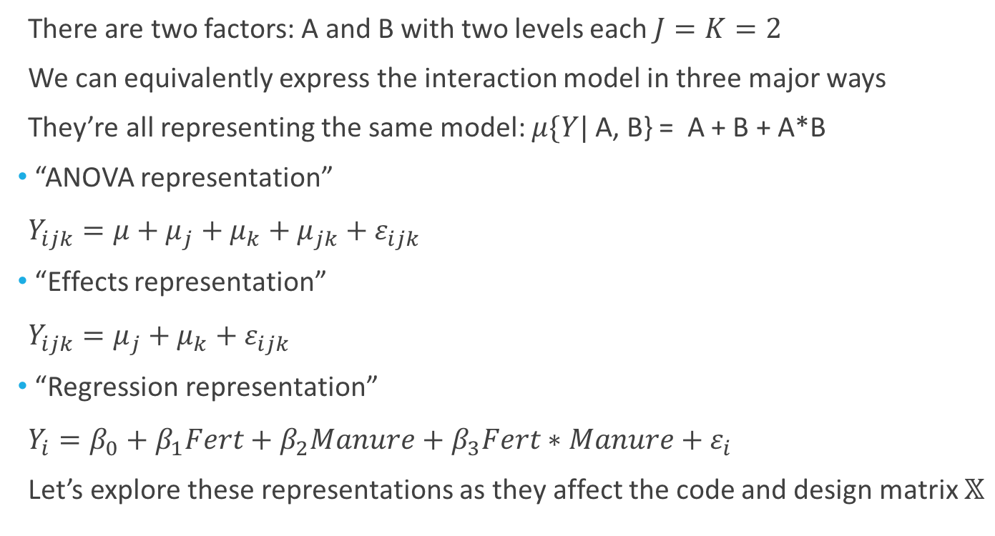
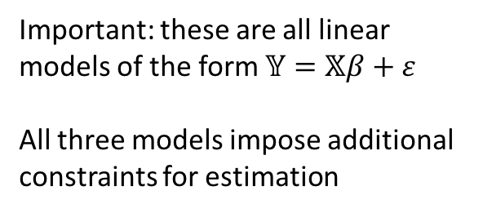
The Notation
There are two factors: A and B with two levels each $J=K=2$
We can equivalently express the interaction model in three major ways
They’re all representing the same model: $μ\{Y|$ A, B} = A + B + A*B
“ANOVA representation”
$Y_{ijk}=μ+μ_{j}+μ_{k}+μ_{jk}+ε_{ijk}$
“Effects representation”
$Y_{ijk}=μ_{j}+μ_{k}+ε_{ijk}$
“Regression representation”
$Y_{i}=β_{0}+β_{1}Fert+β_{2}Manure+β_{3}Fert∗Manure+ε_{i}$
Let’s explore these representations as they affect the code and design matrix $𝕏$
Important: these are all linear models of the form $𝕐=𝕏β+ε$
All three models impose additional constraints for estimation

Slide 10
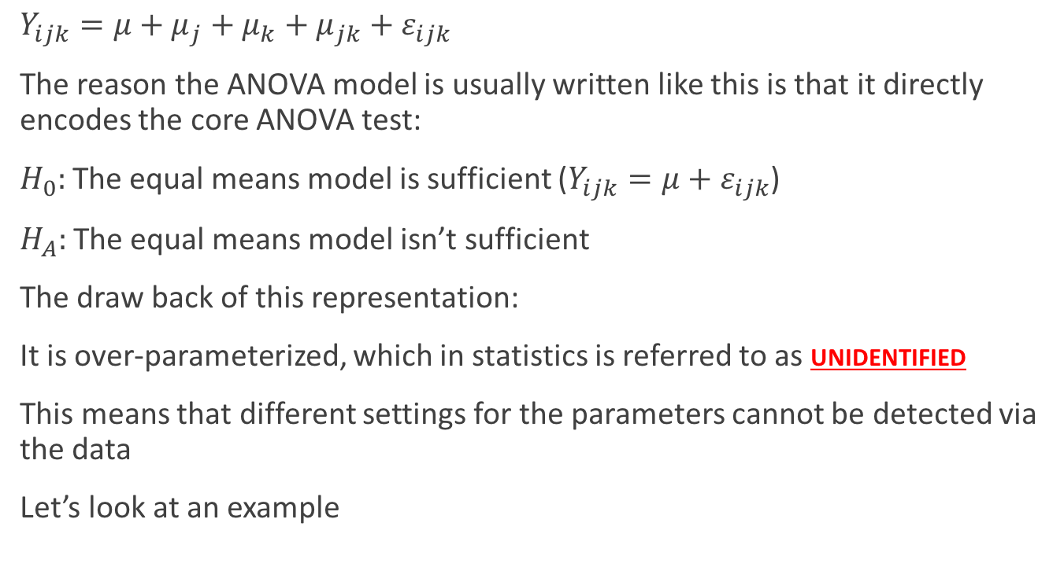
ANOVA representation
$Y_{ijk}=μ+μ_{j}+μ_{k}+μ_{jk}+ε_{ijk}$
The reason the ANOVA model is usually written like this is that it directly encodes the core ANOVA test:
$H_{0}:$The equal means model is sufficient ($Y_{ijk}=μ+ε_{ijk}$)
$H_{A}:$The equal means model isn’t sufficient
The draw back of this representation:
It is over-parameterized, which in statistics is referred to as unidentified
This means that different settings for the parameters cannot be detected via the data
Let’s look at an example

Slide 11
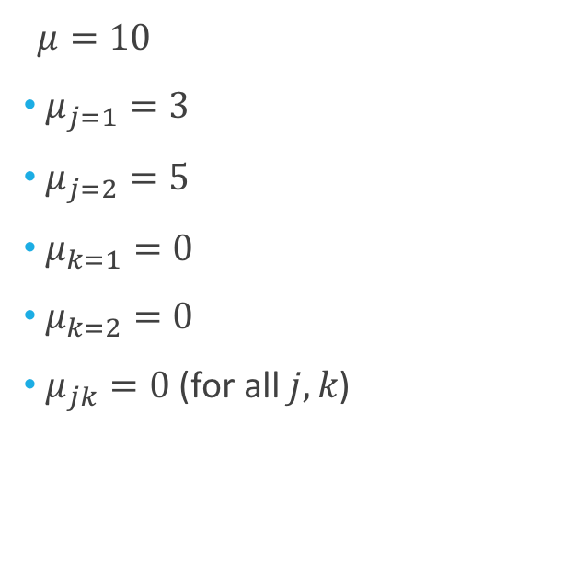
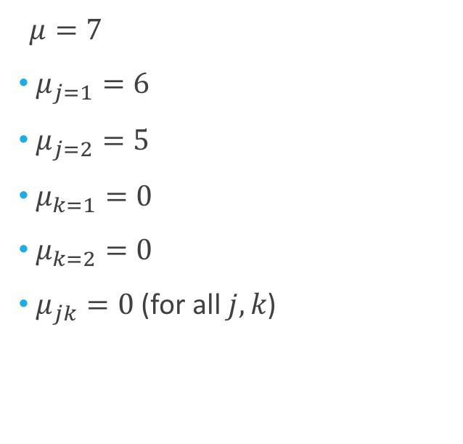
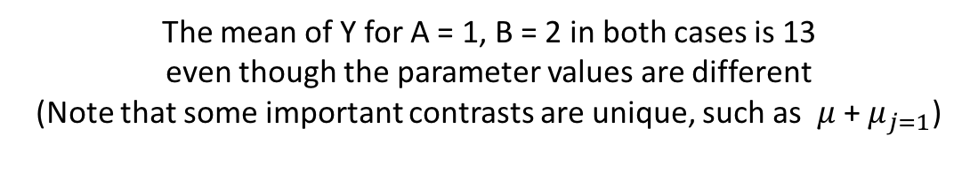
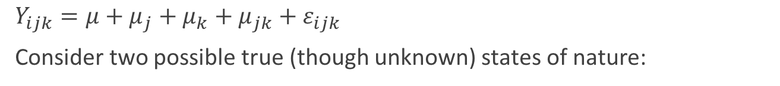
ANOVA representation
$Y_{ijk}=μ+μ_{j}+μ_{k}+μ_{jk}+ε_{ijk}$
Consider two possible true (though unknown) states of nature:
$μ=10$
$μ_{j=1}=3$
$μ_{j=2}=5$
$μ_{k=1}=0$
$μ_{k=2}=0$
$μ_{jk}=0$ (for all $j,k$)
$μ=7$
$μ_{j=1}=6$
$μ_{j=2}=5$
$μ_{k=1}=0$
$μ_{k=2}=0$
$μ_{jk}=0$ (for all $j,k$)
The mean of Y for A = 1, B = 2 in both cases is 13
even though the parameter values are different
(Note that some important contrasts are unique, such as $μ$ + $μ_{j=1}$)

Slide 12
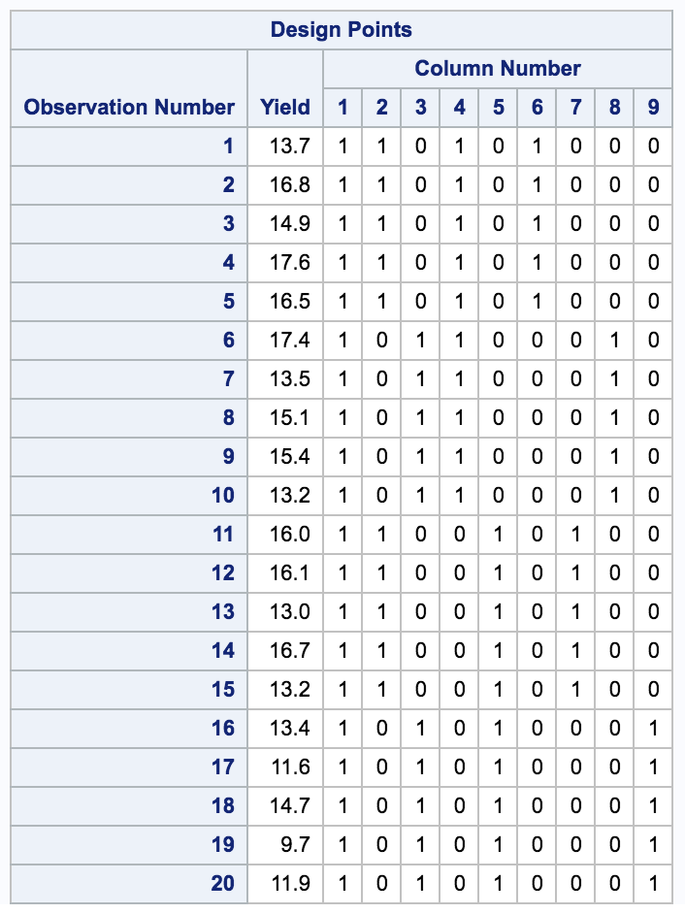
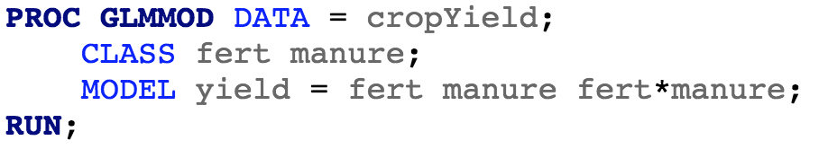
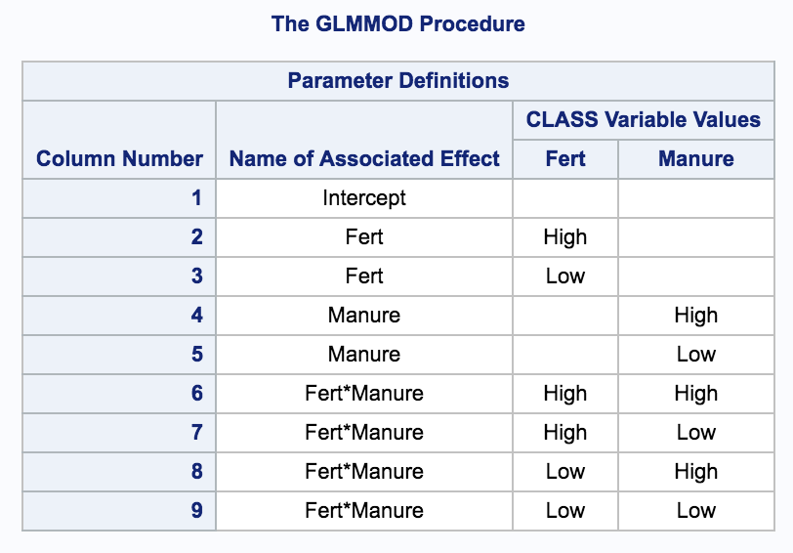
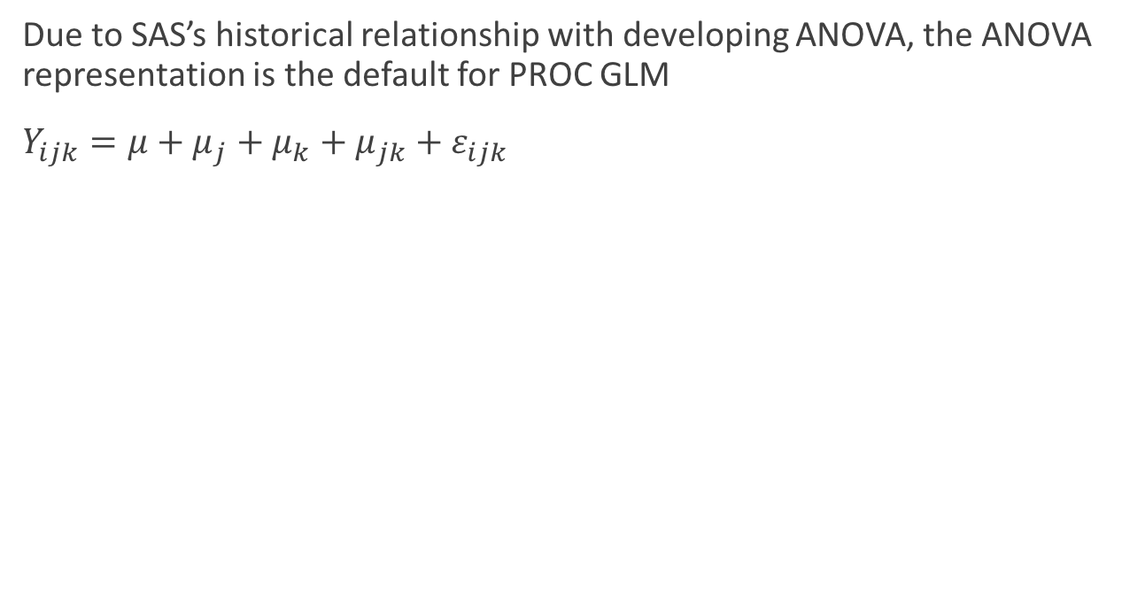
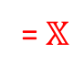
ANOVA representation
Unidentified: Columns are linear combinations
Due to SAS’s historical relationship with developing ANOVA, the ANOVA representation is the default for PROC GLM
$Y_{ijk}=μ+μ_{j}+μ_{k}+μ_{jk}+ε_{ijk}$
= $𝕏$
Notes:
See for details: https://support.sas.com/documentation/cdl/en/statug/63033/HTML/default/viewer.htm#statug_glm_sect029.htm

Slide 13
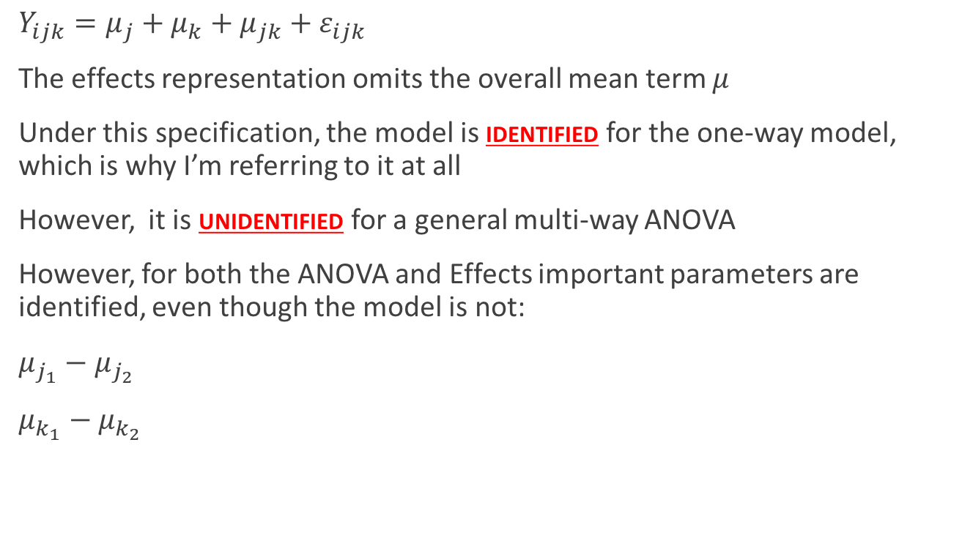
Effects representation
$Y_{ijk}=μ_{j}+μ_{k}+μ_{jk}+ε_{ijk}$
The effects representation omits the overall mean term $μ$
Under this specification, the model is identified for the one-way model, which is why I’m referring to it at all
However, it is unidentified for a general multi-way ANOVA
However, for both the ANOVA and Effects important parameters are identified, even though the model is not:
$μ_{j_{1}}−μ_{j_{2}}$
$μ_{k_{1}}−μ_{k_{2}}$

Slide 14
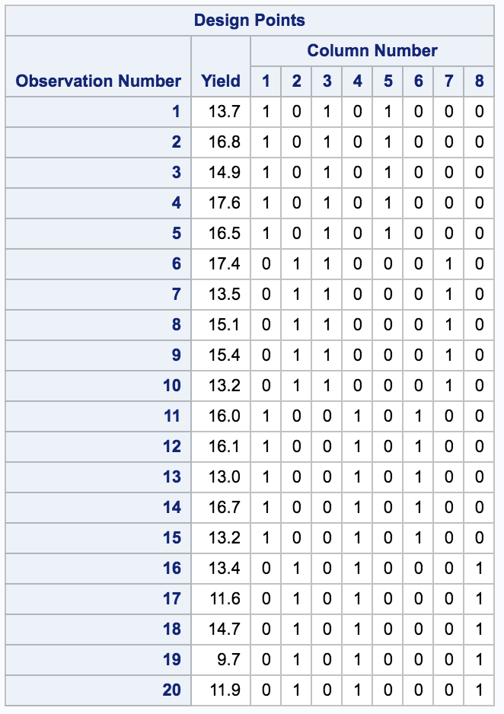
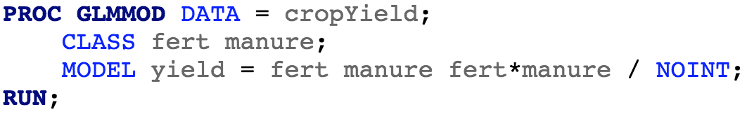
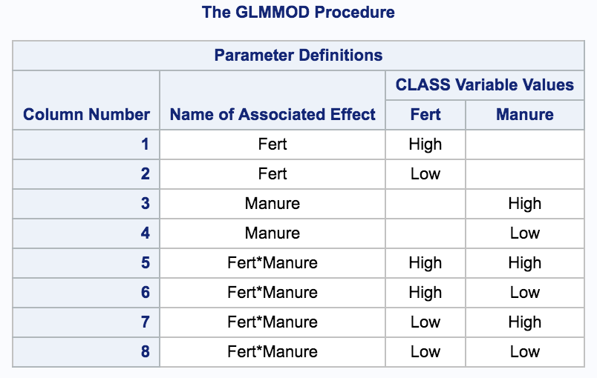
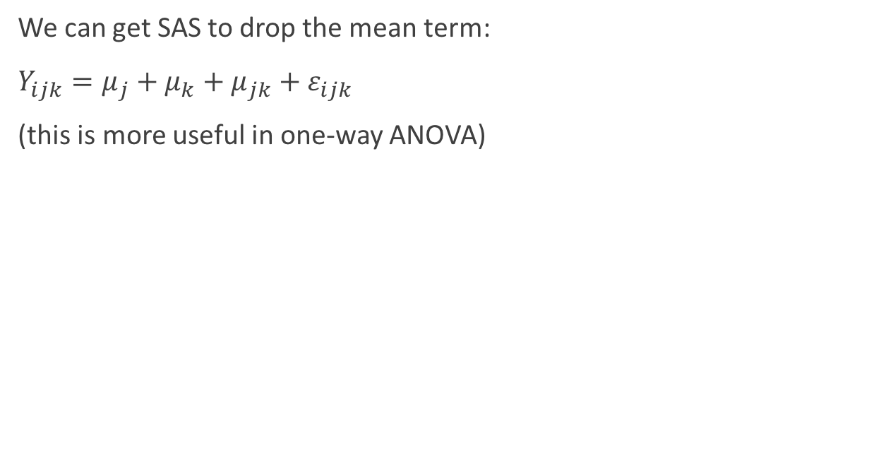
Effects representation
Unidentified: Columns are linear combinations
We can get SAS to drop the mean term:
$Y_{ijk}=μ_{j}+μ_{k}+μ_{jk}+ε_{ijk}$
(this is more useful in one-way ANOVA)
= $𝕏$

Slide 15
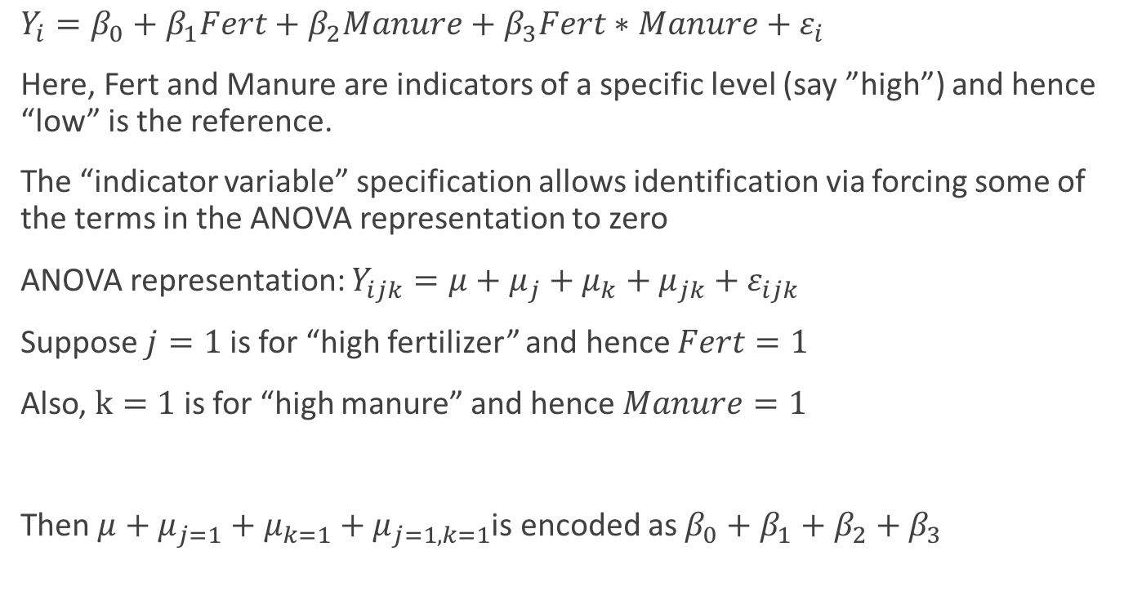
Regression representation
$Y_{i}=β_{0}+β_{1}Fert+β_{2}Manure+β_{3}Fert∗Manure+ε_{i}$
Here, Fert and Manure are indicators of a specific level (say ”high”) and hence “low” is the reference.
The “indicator variable” specification allows identification via forcing some of the terms in the ANOVA representation to zero
ANOVA representation: $Y_{ijk}=μ+μ_{j}+μ_{k}+μ_{jk}+ε_{ijk}$
Suppose $j=1$ is for “high fertilizer” and hence $Fert=1$
Also, $k=1$ is for “high manure” and hence $Manure=1$
Then $μ+μ_{j=1}+μ_{k=1}+μ_{j=1,k=1}$is encoded as $β_{0}+β_{1}+β_{2}+β_{3}$

Slide 16
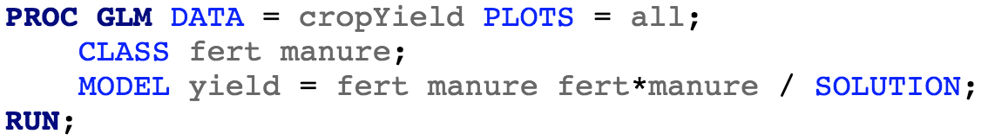
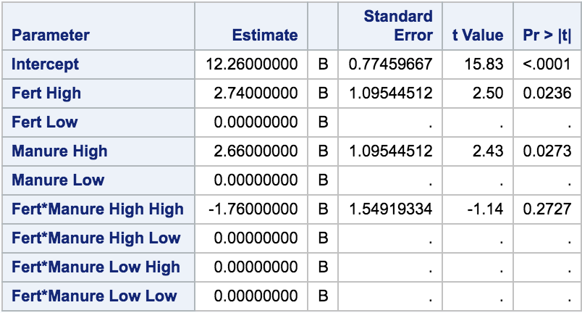
Regression representation
Extra constraints: Force some of the ANOVA model parameters to zero

Slide 17
Back to Crop Yield

Slide 18
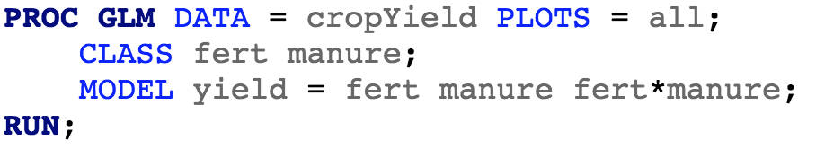
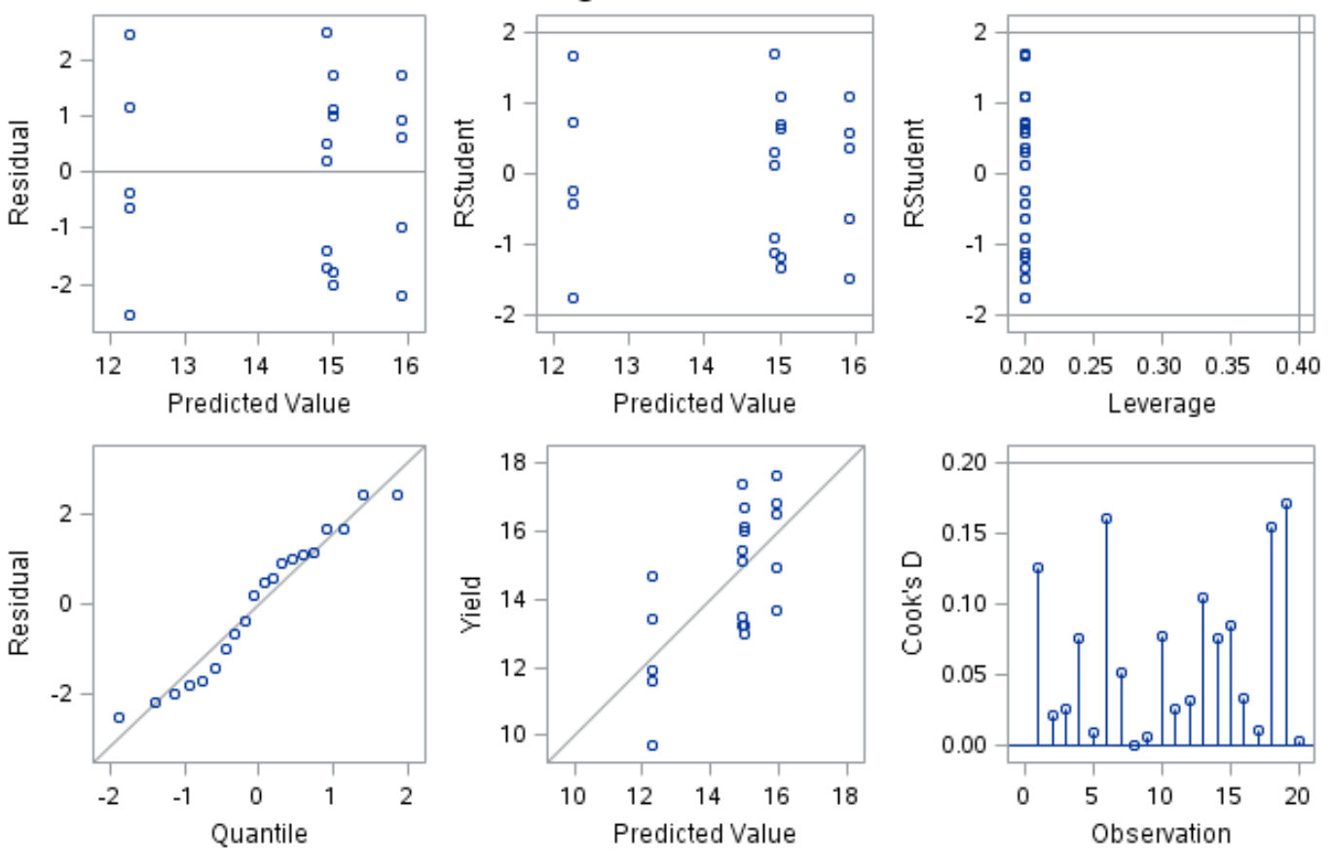
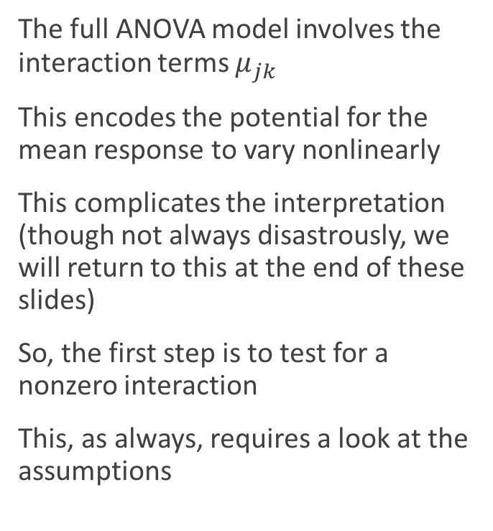
Fitting the Model and Checking Assumptions
The full ANOVA model involves the interaction terms $μ_{jk}$
This encodes the potential for the mean response to vary nonlinearly
This complicates the interpretation (though not always disastrously, we will return to this at the end of these slides)
So, the first step is to test for a nonzero interaction
This, as always, requires a look at the assumptions

Slide 19
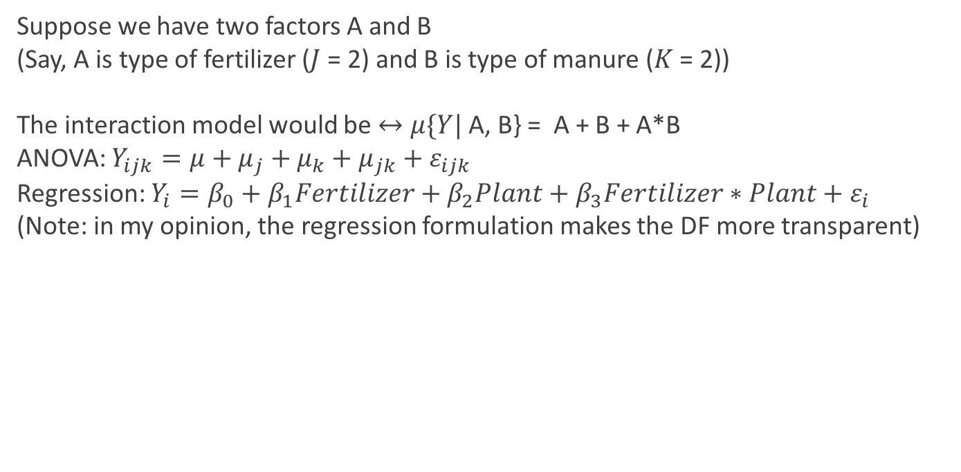
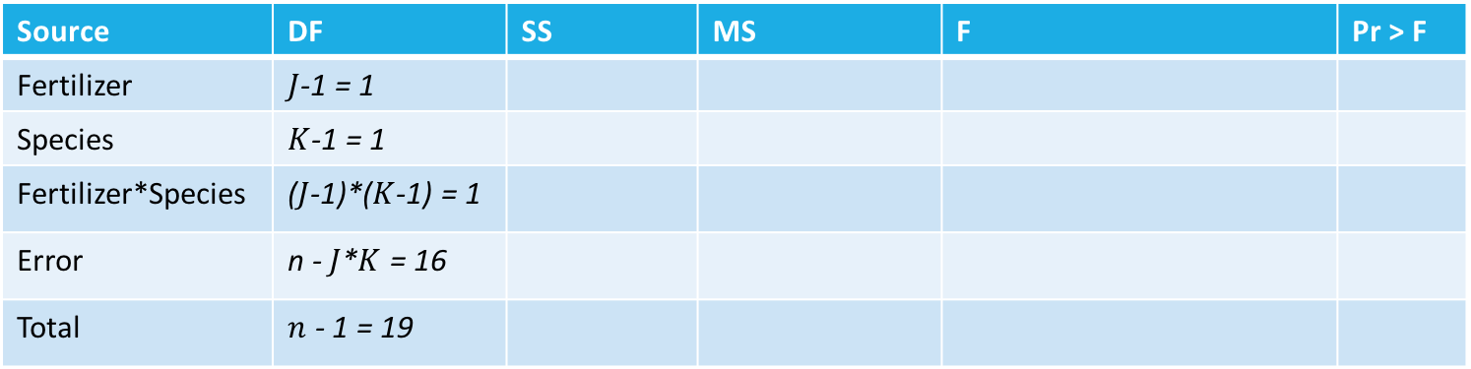
Testing for the Interaction
Suppose we have two factors A and B
(Say, A is type of fertilizer ($J$ = 2) and B is type of manure ($K$ = 2))
The interaction model would be $↔μ\{Y|$ A, B} = A + B + A*B
ANOVA: $Y_{ijk}=μ+μ_{j}+μ_{k}+μ_{jk}+ε_{ijk}$
Regression: $Y_{i}=β_{0}+β_{1}Fertilizer+β_{2}Plant+β_{3}Fertilizer∗Plant+ε_{i}$
(Note: in my opinion, the regression formulation makes the DF more transparent)
Source | DF | SS | MS | F | Pr > F
Fertilizer | $J$-1 = 1
Species | $K$-1 = 1
Fertilizer*Species | ($J$-1)*($K$-1) = 1
Error | n - $J$*$K$ = 16
Total | $n$ - 1 = 19

Slide 20
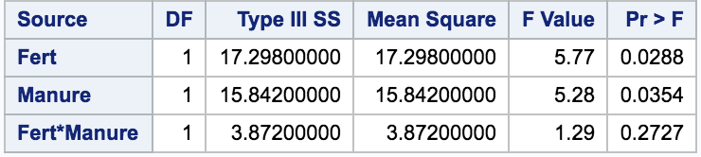
Testing for the Interaction
Note: we will return to Type I vs III SS shortly
Here, no evidence for need of interaction term
Source | DF | SS | MS | F | Pr > F
Fertilizer | $J$-1 = 1
Species | $K$-1 = 1
Fertilizer*Species | ($J$-1)*($K$-1) = 1
Error | n - $J$*$K$ = 16
Total | $n$ - 1 = 19

Slide 21
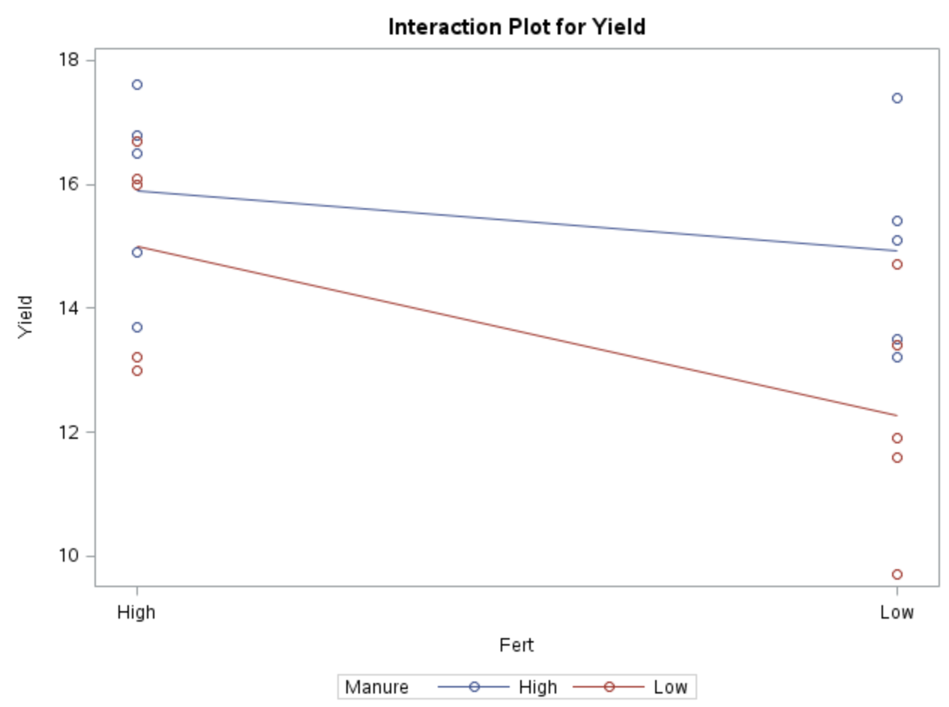
Profile Plot
Reminder: The test for interaction formalizes the question: Are the profile plot lines parallel?
Let’s refit without that term

Slide 22
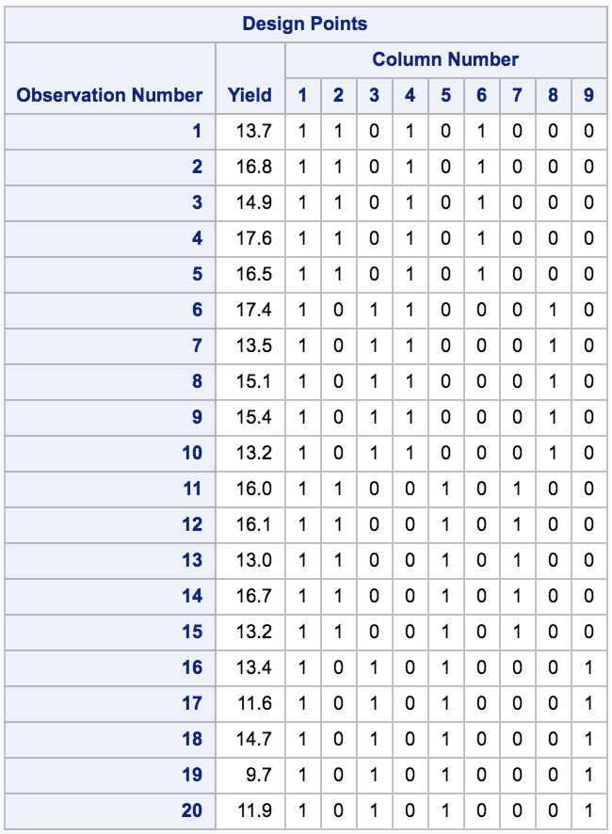
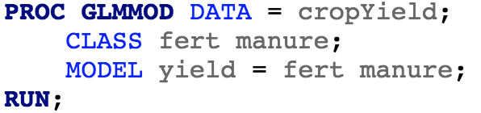
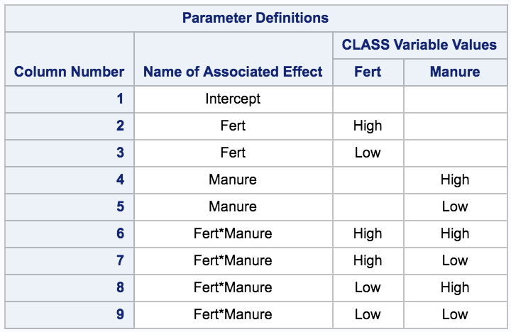
Fitting the Additive Model

Slide 23
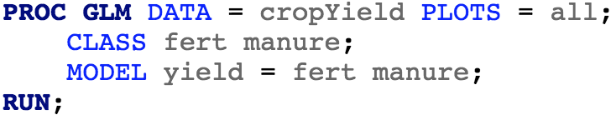
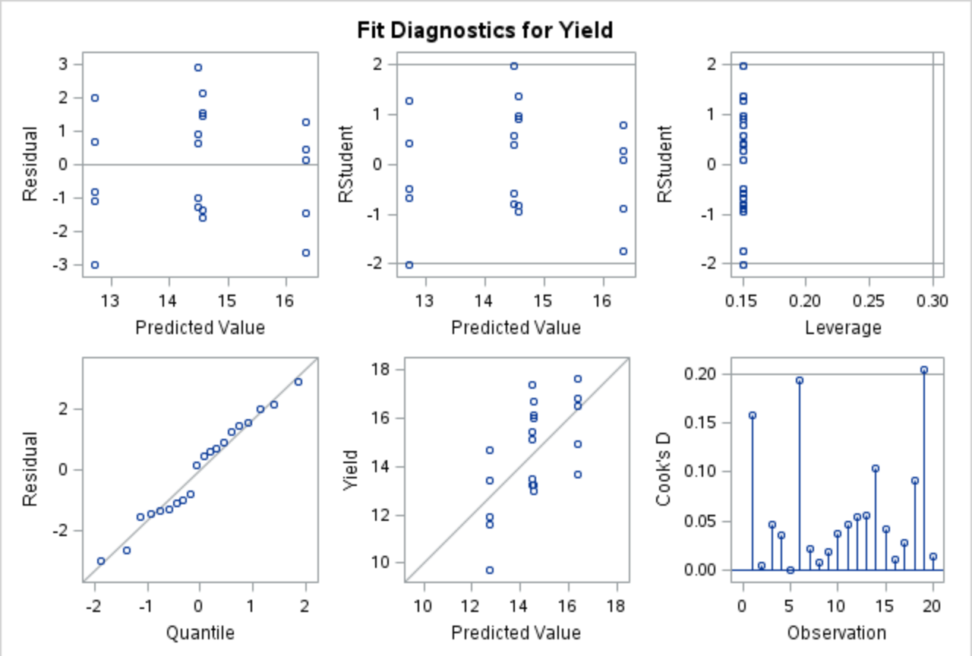
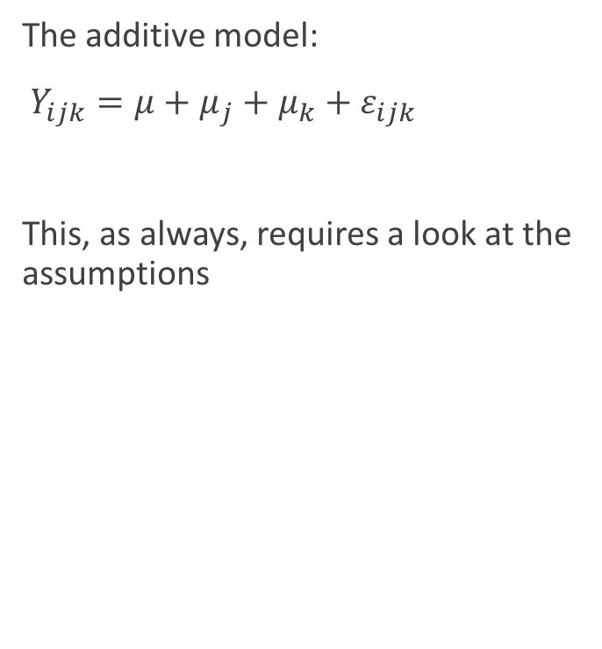
Fitting the Additive Model and Checking Assumptions
The additive model:
$Y_{ijk}=μ+μ_{j}+μ_{k}+ε_{ijk}$
This, as always, requires a look at the assumptions

Slide 24
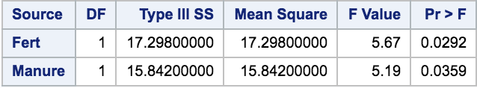
Fitting the Additive Model
Here, there is evidence of a treatment effect for both Fertilizer and Manure

Slide 25
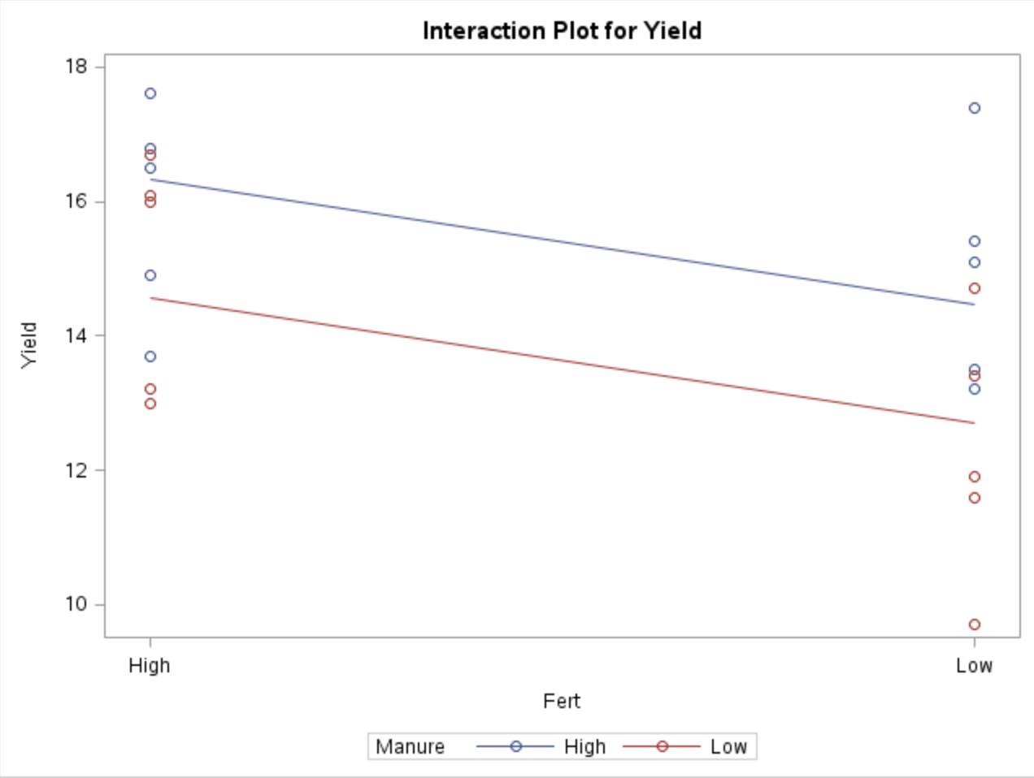
Profile Plot
Important: The additive model fit will always have parallel lines, this provides no evidence against an interaction
What about estimating the effect?

Slide 26
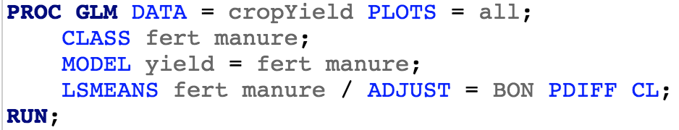
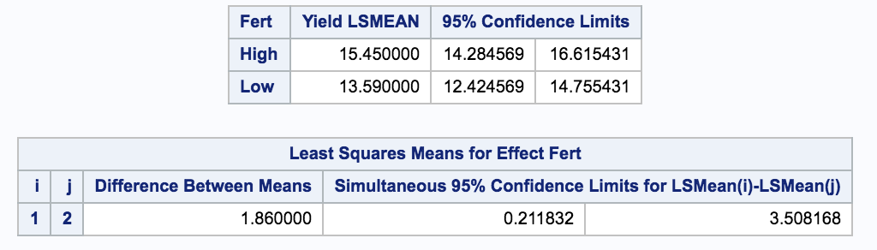
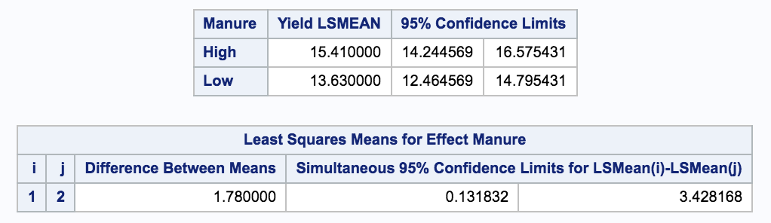
Estimating the Additive Model
This produces least squares estimates or each level of each factor as well as a confidence interval for differences between the levels

Slide 27
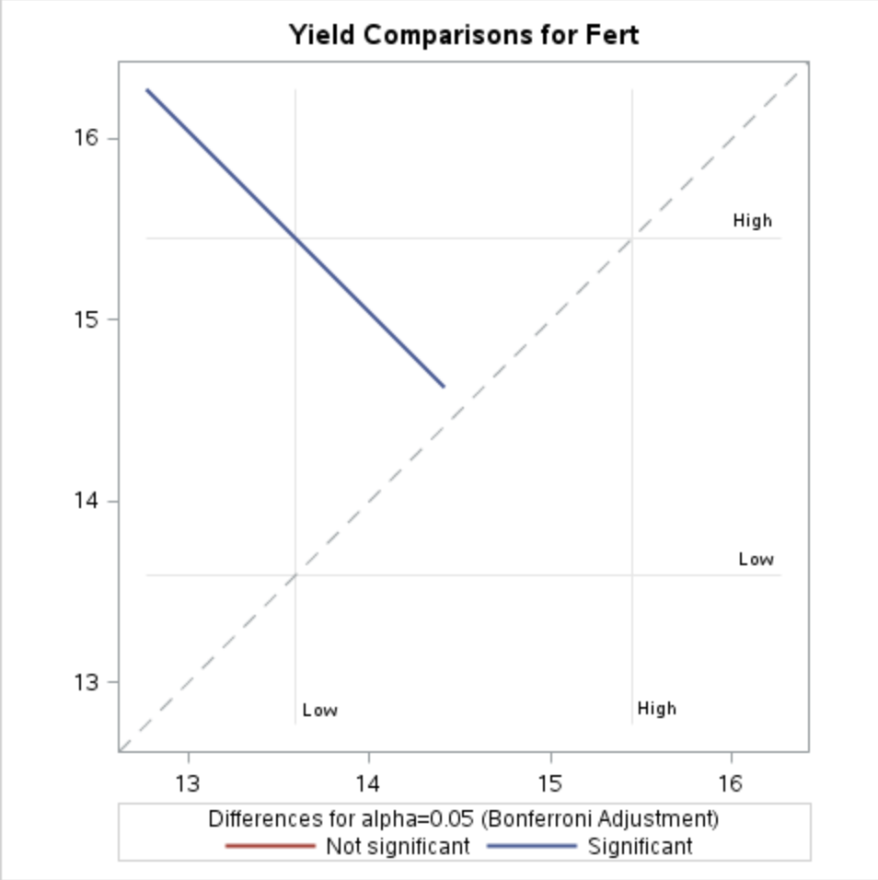
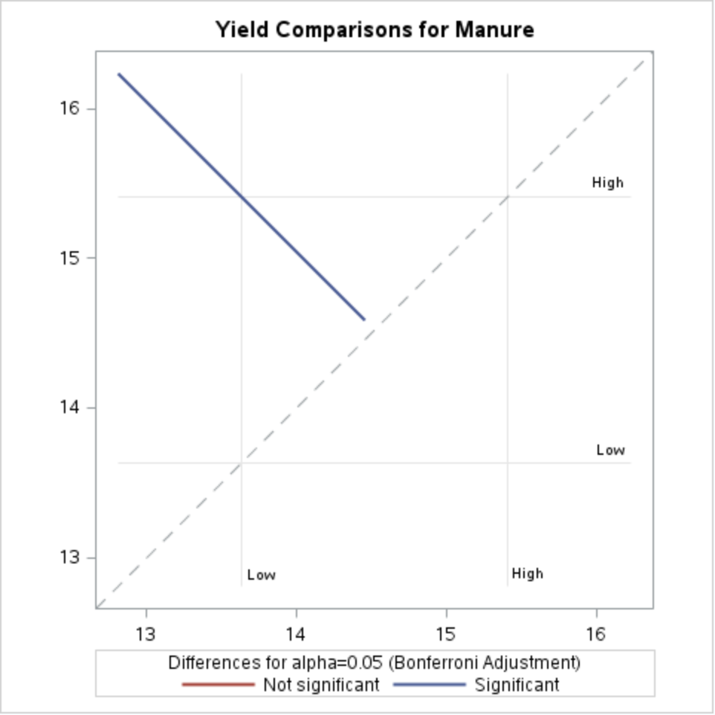
Estimating the Additive Model

Slide 28
What if There Was an Interaction?
(note: I’m not indicating this analysis should be done in this case. I’m just showing what lsmeans looks like with an interaction)

Slide 29
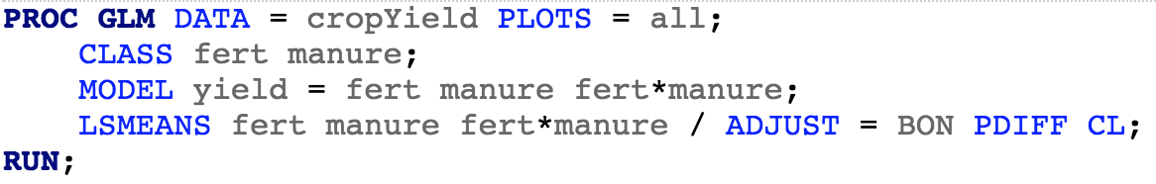
With an Interaction
This will estimate/compare the levels but take into account the interaction

Slide 30
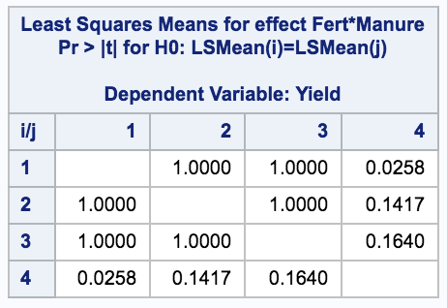
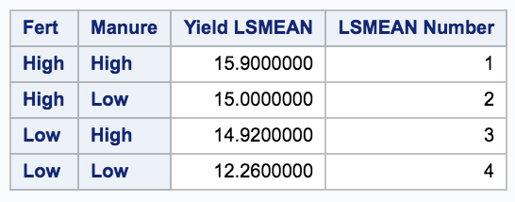

With an Interaction

Slide 31


With an Interaction

